Slide 1
(user) authentication:
On the extreme weakness of passwords

Slide 2
Password or secret key?
Authentication
Prove I know a password or a secret
Passwd or secret? conceptually the same
A password is (should be) a secret
Practically there is a HUGE difference
Secret ley: a random string of N bit
Probability to guess it = 1 out of 2^{N}
Password: a low-entropy string!!
Probability to guess it: MUUUUCH lower than n = 1 out of 2^{N}

Slide 3
Password: four major problems
Password overload
users VERY often reuse passwords across different sites
Restricted charset
Not all possible characters are used!
Low entropy
Password meant to be remembered: not nearly random!
Predictability (and dictionary attacks)
Bad habits in choosing passwords
Use human-friendly rules to “generate” passwords

Slide 4
Issue 1: password overload
Average # of digital accounts per person in US: 130 (!!)
2017 statistics
38% of users reuse identical password across sites
Source: 2018 scientific paper (*)
21% of users modify password…
But «rules» used are VERY predictable:
30% cracked in 10 or less attempts
46.5% cracked in 100 or less attempts
Modification examples from (*):
danilo → da11nilo butcher69 → butcherboy Martin1 → martin1 fishkakemmm → fishkake333
VERY SERIOUS SECURITY ISSUE:
Cross-site breach!
Password reuse: ever many years after a breach
(*) https://people.cs.vt.edu/gangwang/pass

Slide 5
Issue 2: restricted charset
Secret key = 8 bytes
1 byte = 256 possible values
Probability of guess = 1/256
Probability of guessing all 8 bytes
1/256 * 1/256 * … (8 times) = 1 / 256⁸
= 1 / 18.446.744.073.709.551.616
Assuming 66M guesses/s
We will see later on why this number!
Average guess time = 1.8x10¹⁹ / 6.6x10⁷ / 2 seconds = 4431 years
Passwd = 8 bytes
But if you use only low case letters and numbers?
1 byte = 36 possible values!
Probability of guessing all 8 bytes password
1 / 36⁸ = 1 / 2.821.109.907.456
Average guess time = 2.8x10¹² / 6.6x10⁷ / 2 seconds = 5.9 hours!!

Slide 6
Issue 3: low entropy
With (very!) rare exceptions, passwords (human generated strings) do not «look» random
10 letter truly random examples computed using https://www.random.org/strings/
wykvpdslzb, iuxdacetyu, sermfokoia, zpkwtrehjv, grsshdnixc, axqeudtijf, jzmkmhlsop
How to «quantify» randomness?
(Shannon) Entropy!

Slide 7
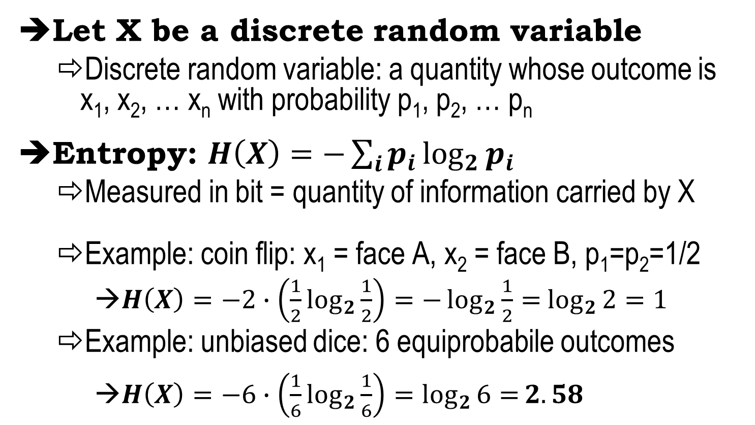
Entropy
Let X be a discrete random variable
Discrete random variable: a quantity whose outcome is x₁, x₂, … x_{n} with probability p₁, p₂, … p_{n}
Entropy: $H\left(X\right)=−\sum_{i}{p_{i}}\log_{2}{p_{i}}$
Measured in bit = quantity of information carried by X
Example: coin flip: x₁ = face A, x₂ = face B, p₁=p₂=1/2
$H\left(X\right)=−2∙\left(\frac{1}{2}\log_{2}{\frac{1}{2}}\right)=−\log_{2}{\frac{1}{2}=}$ $\log_{2}{2=1}$
Example: unbiased dice: 6 equiprobabile outcomes
$H\left(X\right)=−6∙\left(\frac{1}{6}\log_{2}{\frac{1}{6}}\right)=\log_{2}{6=}2.58$

Slide 8
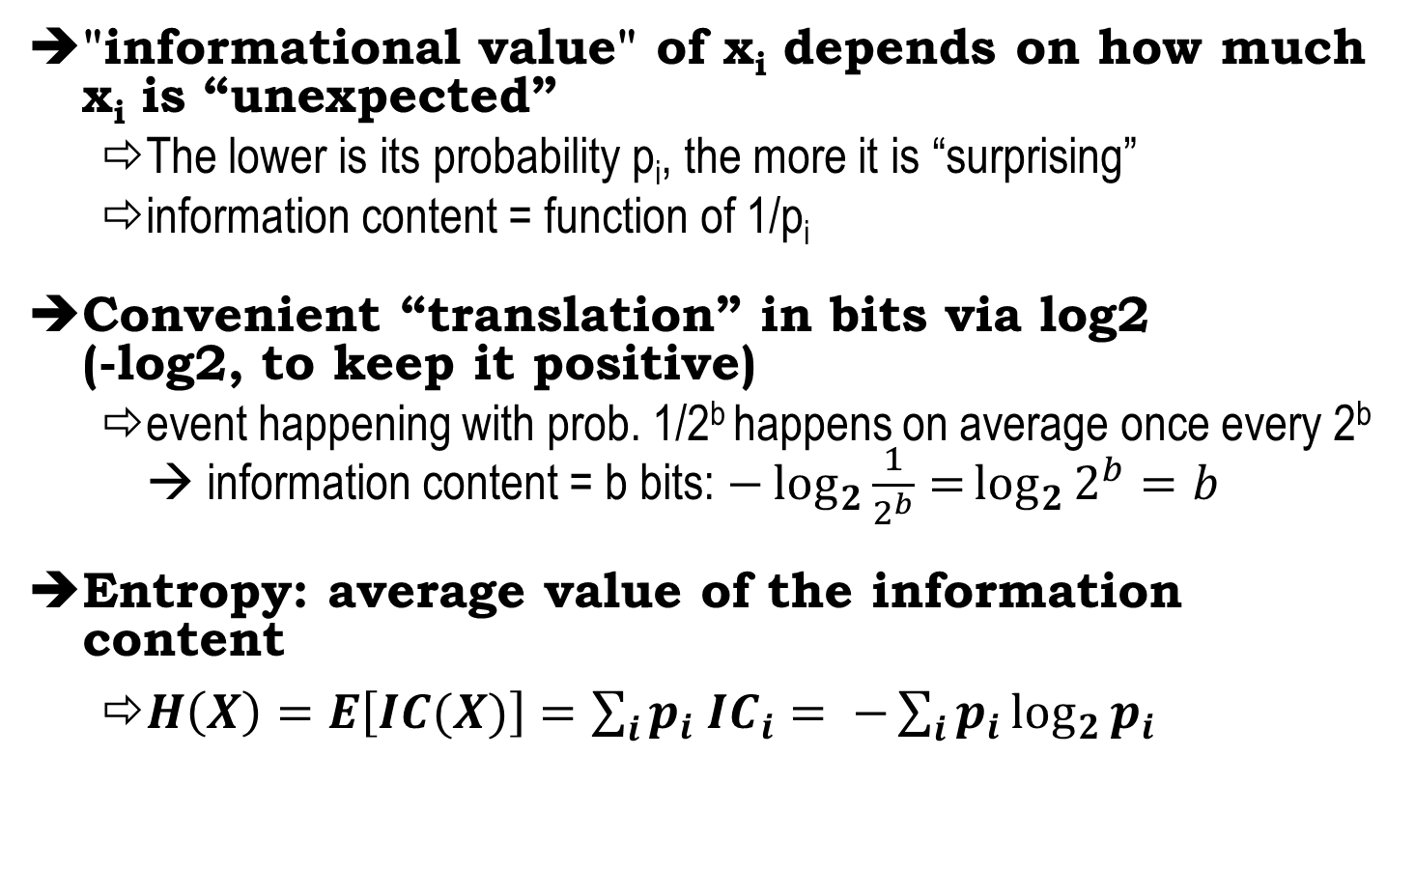
Why this mathematical definition? (Shannon Information theory, 1948)
"informational value" of x_{i} depends on how much x_{i} is “unexpected”
The lower is its probability p_{i}, the more it is “surprising”
information content = function of 1/p_{i}
Convenient “translation” in bits via log2 (-log2, to keep it positive)
event happening with prob. 1/2^{b} happens on average once every 2^{b} → information content = b bits: $−\log_{2}{\frac{1}{2^{b}}=}\log_{2}{2^{b}=b}$
Entropy: average value of the information content
$H\left(X\right)=E\left[IC(X)\right]=\sum_{i}{p_{i}{ IC}_{i}}= −\sum_{i}{p_{i}}\log_{2}{p_{i}}$

Slide 9
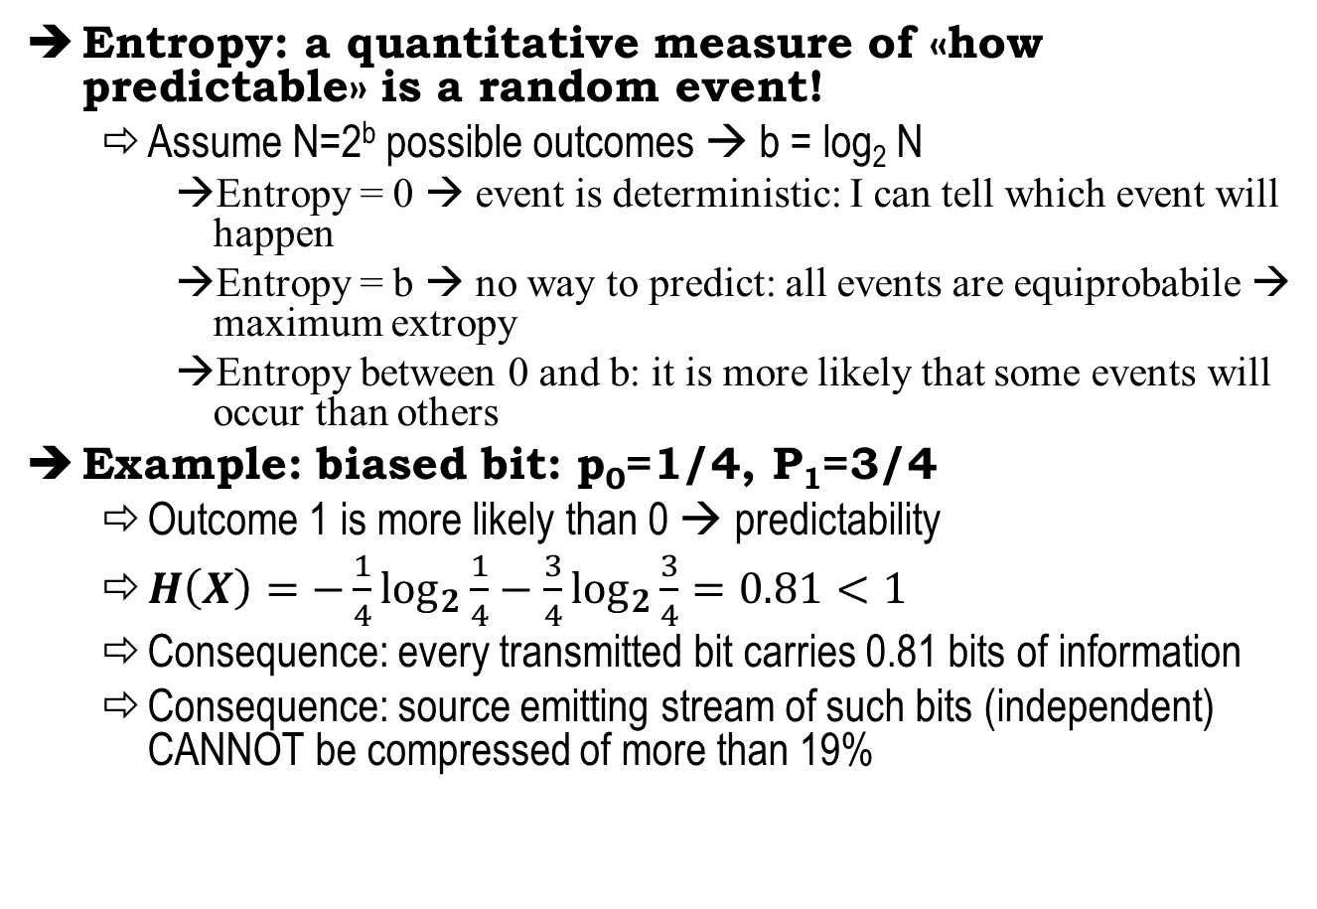
Entropy and predictability
Entropy: a quantitative measure of «how predictable» is a random event!
Assume N=2^{b} possible outcomes → b = log₂ N
Entropy = 0 → event is deterministic: I can tell which event will happen
Entropy = b → no way to predict: all events are equiprobabile → maximum extropy
Entropy between 0 and b: it is more likely that some events will occur than others
Example: biased bit: p₀=1/4, P₁=3/4
Outcome 1 is more likely than 0 → predictability
$H\left(X\right)=−\frac{1}{4}\log_{2}{\frac{1}{4}}−\frac{3}{4}\log_{2}{\frac{3}{4}}=0.81<1$
Consequence: every transmitted bit carries 0.81 bits of information
Consequence: source emitting stream of such bits (independent) CANNOT be compressed of more than 19%

Slide 10
Test your understanding (Entropy and dependence)
Bit flip: X_{k} = {0,1} with probability ½
Entropy = 1 bit
Entropy of sequence of independent r.v.: X₁ X₂ X₃
Entropy = 3 bits
What if they are dependent?
X₁ is bit flip, but X₂ and X₃ have same value as X₁
Hence they are still {0,1} with probability ½ but depend on the previous value
Entropy = ???
Answer: 1 bit!
Why? Two trivial explanations
Information is only carried by one bit (bit X₁)
r.v. Y = X₁ X₂ X₃ has only two outcomes; 000 and 111, with p=½

Slide 11
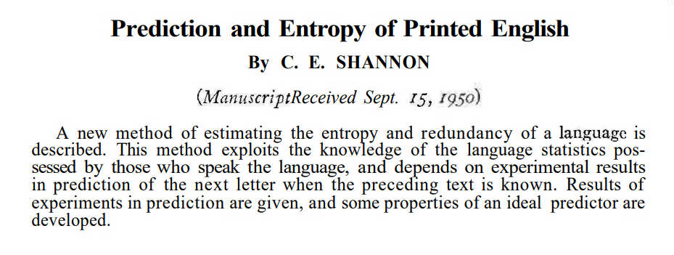
Couple of bits/letter!! MUCH lower than uniform random letters – brute-force crack:
random 10 letters → 2^{(4.7 x 10)} = 2⁴⁷
Human-generated →about 2^{(2 x 10)} = 2²⁰ factor of 2²⁷ ~ 100M times less than computer-generated! But is worse than this, see next issue 4

Slide 12
Issue 4: dictionary attacks
Password guessing heuristics; improve brute-force
Use set of «common» words (dictionary)
Use «public» password databases
Obtained from breaches (e.g. published by hacking groups)
Use dictionaries customized to targeted victim
Her interests, her context, etc
Usually complemented by social engineering
Use password modification rules (more later)
Types of attack
Online → easy to defend (limit #attempts → account lockout)
Offline (against hashed pw) → no defence
(except chosing strong passwords)

Slide 13
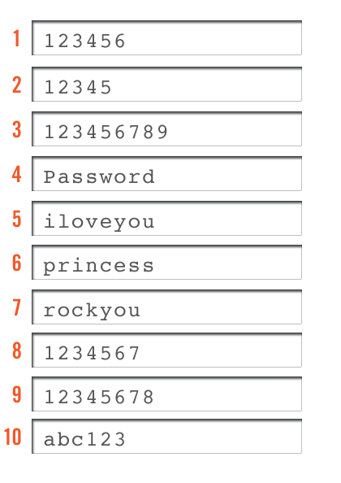
Some statistics
Common passwords choice
25% similar to TOP-20
That’s why password spraying attacks are VERY effective…
16% first name
4% "password" variant
Common passwords length
26% length of 6 byte
19% length of 7 byte
20% length of 8 byte

Slide 14
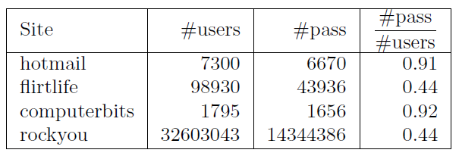
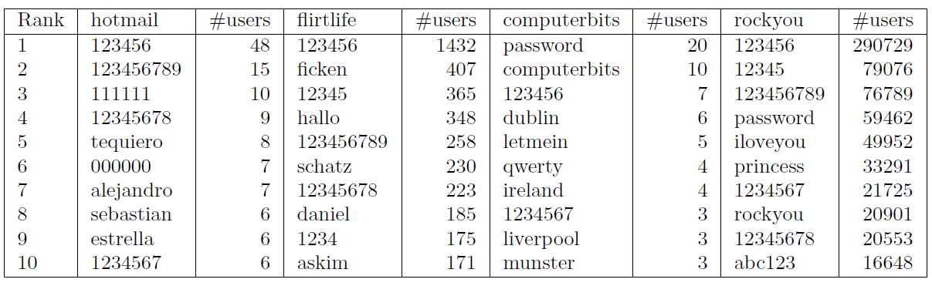
More detailed stats source: David Malone, Kevin Maher, Investigating the Distribution of Password Choices, 2011
4 datasets analyzed
Top 10 per each dataset

Slide 15
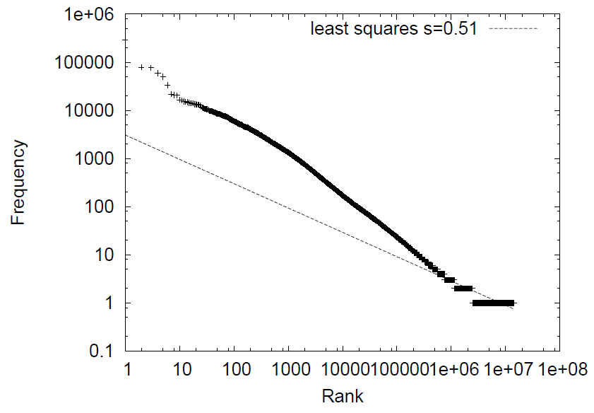
More detailed stats source: David Malone, Kevin Maher, Investigating the Distribution of Password Choices, 2011
Rank/frequency plot
(out of about 32M
total)
unique passwd: only these!!

Slide 16
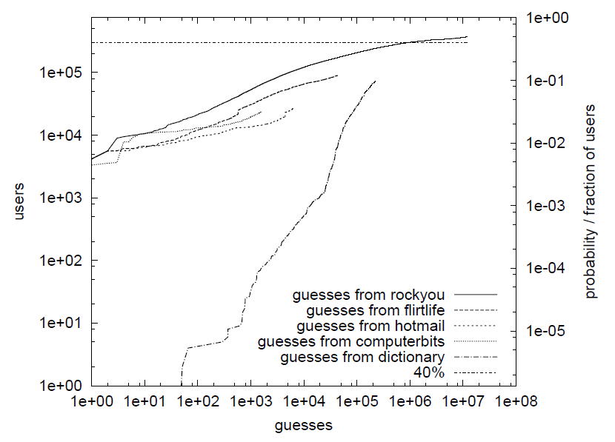
More detailed stats source: David Malone, Kevin Maher, Investigating the Distribution of Password Choices, 2011
Use public passwd DBs to crack new ones (Gawker.com, released in 2010)
10% of all users after just o(1000) guesses!
Normal dictionary:
10% of users would have required almost 200.000
guesses!

Slide 17
Dictionary rule-based attacks
SW specialized to «crack» a (protected, will see later) passwd database
E.g., John the Ripper, hashcat, etc
Two main components
A baseline database
Passwd generation rules
…
giuseppe
genesis
…
Uppercase → GIUSEPPE
Capitalize → Giuseppe
Append/prepend $1 →giuseppe1
$abc → giuseppeabc
^00 → 00giuseppe
Replace si1 → g1useppe
se3 → gius3pp3
And many more, plus combinations of

Slide 18
Password-Based Authentication
Vs
Challenge-Handshake Authentication
PAP, CHAP

Slide 19
Authentication: “proof of…”
To “prove” I know a password does NOT necessarily imply revealing it
Though revealing the password is ONE POSSIBLE approach
We will see the PAP protocol later on – Passwd Auth Protocol
Different techniques → different levels of information disclosure
PAP = full disclosure
CHAP = some information leaks
ZKP = no information leakage

Slide 20

Password Authentication Protocol (PAP) Simplest possible auth approach
Prove you know your password by… showing it in clear!
User
Authenticator
User_ID: GB
Passwd: pippo
{GB, pippo}
User Database
UID PW
…
…
OK, you’re in!
GB
pippo
…
…

Slide 21
PAP obvious limitations
Passwords sent “in clear”
If the channel permits eavesdropping (e.g. wireless networks), then game over
No protection from replay attacks
You don’t even need a “true” replay attack, since attacker already learns the password!
No protection from repeated trial and error attacks
Peer is in control of the frequency and timing of the attempts.

Slide 22
PAP message example (real capture of a PPP trace)
… c0 23 01 09 00 20 12 65 75 32 35 36 33 36 37 38 40 74 65 6c 65 32 2e 69 74 08 39 64 77 63 2d 75 6a 6e
e u 2 5 6 3 6 7 8 @ t e l e 2 . i t
9 d w c - u j n
PPP-PAP
Code 01
Auth-req
ID=09
User id = 18 bytes
Password = 8 bytes
Len=32 bytes (0x0020)
ALL UID+PW IN CLEAR!!!!

Slide 23
CHAP Challenge Handshake Authentication Protocol

Slide 24
Authentication: “proof of…”
Authentication: prove you know a secret or a password
PAP: prove you know the secret passwd by explicitly telling it to the authenticator
If attacker can hear this, game over
If attacker can replay this, game over
Are there alternatives? Yes!

Slide 25
Proof of knowledge: result of computation!
I’m not telling you P
But I’m telling you F(P)
I’m able to compute this only because I know P
Which F(.)? Two properties
Computation must NOT reveal the secret itself: If res = F(P), P = F⁻¹(res) must NOT be computable…
We will very soon meet functions with such property ☺
F(P) must not be replayed by attacker! F cannot be a function only of P, but must include a nonce

Slide 26
Challenge-Handshake Auth Protocol (CHAP)
2) UID, R = H(Challenge, Pw, etc)
Authenticator
Remote User
User Database
1) Challenge
…
…
UID
pass
…
…
R=X??
3) Success, Failure
X=H(Challenge, pass, etc)
Secret passwd never transmitted in clear
Secure against adversary that can eavesdrop the channel
Hash is the usual approach, but it is NOT the only one
Other common approach: encrypt challenge using P as secret key. But requires more care!

Slide 27
CHAP pros & cons
Pros:
Protection against playback (replay) attack
But make sure challenge NEVER repeats!
Repeated challenges
Authentication may be repeated over connection time (unlike PAP where it is performed only once at start)
Authenticator controls frequency and timing of the challenges
intended to limit the time of exposure to any single attack
Initiated by Authenticator
Peer cannot initiate, as challenge must first be sent
Cons:
Secret must be available in plaintext form
Cannot use irreversibly encrypted password databases
More later on this

Slide 28
So, PAP vs CHAP: which one is better then? (less obvious than what you might think at this stage!!!)

Slide 29

2 main (*) attack models
Communication channel
UID - passwd
database
Attack to the communication channel
Eavesdropper, MITM, replay, …
Game Over!
If you want to use PAP, you MUST protect communication channel
E.g. online login via https, EAP-TTLS, etc
Attack to the backend UID-passwd database
Attacker penetrates system and steals entire passwd DB
Mitigation: hashed password database!
(*) other system-level attacks: insiders, workstation hijacking, key loggers, fake screens, etc

Slide 30
Hashed passwd database in PAP
Idea: store H(passwd) instead of passwd
Improved security: if attacker steals DB, still has to «invert» passwd
Good hash = one-way → only method is brute-force/guess
Security ultimately depends on choosing «strong» passwd
Authenticator
User
Compute α=H(pippo)
User_ID: GB
Passwd: pippo
Retrieve β
{GB, pippo}
check α=β?
OK
… … …
GB→β=H(pippo)
… … …

Slide 31
What about CHAP?
Communication channel
UID - passwd
database
Attack to the backend UID-passwd database
CHAP: cannot anymore hash passwd!!!
Conclusion
If Attacker = eavesdropper, then CHAP better
But if Attacker = backend, then PAP better!
Hence there is not a «single» solution, but all depends on which attack you aim at defending

Slide 32

Why no hashed pw in CHAP?
CHALLENGE = 135623
RESPONSE = Flavia, H(mypass | 135623)
User Database
…
…
ACK or NACK
flavia
mypass
…
…
No way to compute H(pw, challenge) without having pw in clear!
Consequence: user DB must remain in clear → straightforward target for attack!
Conclusion: CHAP is worse than PAP against a backend attack model!!

Slide 33
Mitigation: (explicit) “salt”
CHALLENGE = 135623; SALT = 9876
RESPONSE = Flavia, H(H(9876,mypass) | 135623)
ACK or NACK
User Database: SALT=9876
Same idea as previous salt
Salt value is in clear
Store H(salt, passwd)
very different reason and use!
Attacker cannot anymore «reuse» stolen passwd!
But of course passwd strength and dictionary attacks still hold…
After a breach (or periodically), regenerate entire DB using new salt
…
…
flavia
H(9876,mypass)
…
…

